Slide 1
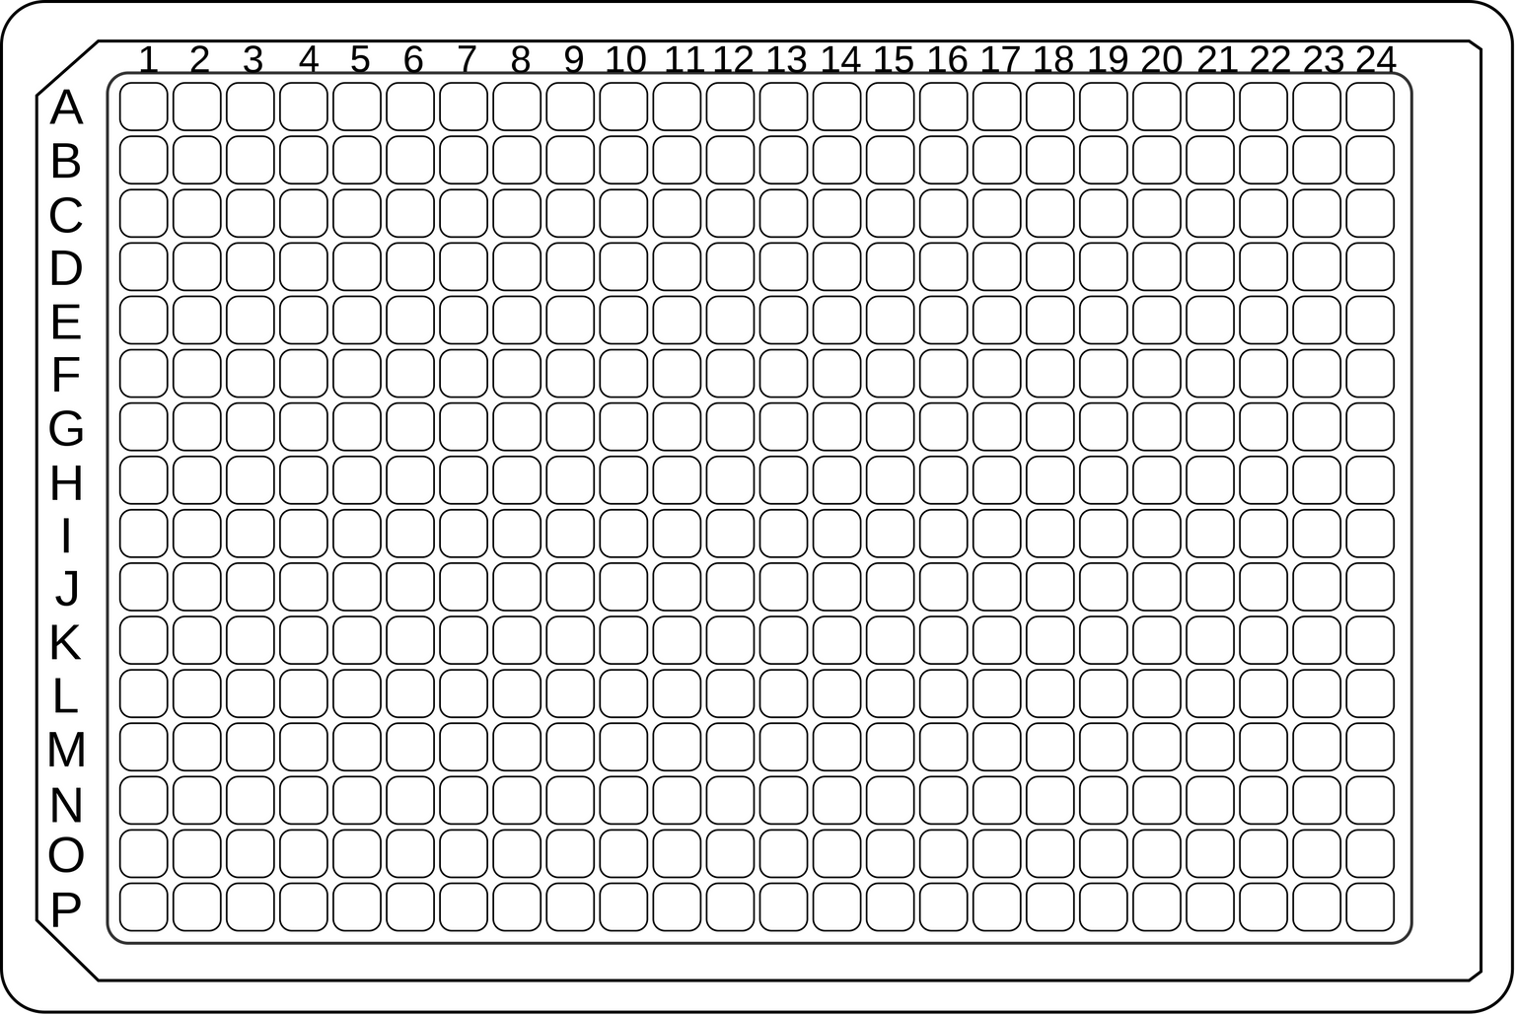
384 Well Plate Template

